Slide 1
Deploy & Scale Prototypes for Production
Module 6
Notes:
Module 6: Deploy and Scale Prototypes Production

Slide 2

Class Expectations
Cameras On
Be present and visible with your camera on to stay engaged in class.
Arrive On Time
Respect everyone’s time by arriving promptly to sessions.
Active Engagement
During exercises and labs, participate actively in all discussions and activities.
📹
⏰
✋
Network
During class, connect with peers and build your learning network.
Use Slack
Use Slack for all communication to keep questions and comments organized.
Instructor Support
Save deeper questions for after class with your instructor so as to not stop class flow.
🌐
🎓
Notes:
Notes
📌Note for instructors: Please do not share the link to the slide deck with students. If they want to view the deck, send them to the LMS where they can view it from there.
Where to access content? You can view the deck from Docebo.
ℹ️ All students should have access to the LMS (Docebo) with all the class materials by now. If not, please reach out to Student Success directly in Slack.

Slide 3
AI Prototyping Certification Syllabus
Accelerate the Idea-to-Validation Cycle
Shift from static specs to interactive prototypes that win alignment fast. Learn why AI prototyping is a critical PM skill reshaping the role, and experience firsthand how to turn ideas into prototypes in minutes.
Write Advanced Prompts for High-Fidelity Prototypes
Master prompting as a core execution skill for the modern PM. Move beyond simple commands to learn the advanced, structured techniques that generate functional, high-fidelity results.
Define the Modern Specs for Prototype Development
Master the new approach to requirements with the one-page prototype spec. Learn to transform your prototype into a clear, actionable document that drives team alignment and accelerates development.
MODULE 1
MODULE 2
MODULE 3
Build, Iterate, and Debug Prototypes End-to-End
Translate specs into working prototypes and test in real time. Use AI as a co-pilot to debug quickly, reduce risks, and ensure your builds are resilient, scalable, and ready to evolve.
Power Advanced Prototypes With API Integrations
Take your prototype to the next level by incorporating advanced, secure integrations. Learn the workflow design for connecting to live APIs while ensuring compliance, scalability, and stability.
Deploy and Scale Prototypes Into Production
Master the fastest path from a working prototype to production. Learn to manage the final deployment and handoff, leveraging rapid iteration to save significant engineering time and cost.
MODULE 4
MODULE 5
MODULE 6
Notes:
AI Prototyping Certification Syllabus
Build, test, and ship interactive AI prototypes that turn ideas into working products in record time.

Slide 4
Agenda
01 The AI Prototype Deployment Strategy
02 Hands-On Lab: Sync Your Prototype to GitHub
03 Collecting Feedback for Improved Prototype Iterations
04 Group Project Showcase: Prototype Demo & Insights
Notes:
Agenda
The AI Prototype Deployment Strategy
Hands-On Lab: Sync Your Prototype to GitHub
Collecting Feedback for Improved Prototype Iterations
Group Project Showcase: Prototype Demo & Insights

Slide 5
The AI Prototype Deployment Strategy
Notes:
01. The AI Prototype Deployment Strategy

Slide 6
The Medium Dictates the Feedback
Don't ask stakeholders to imagine the solution—let them hold it. Deployment removes the "imagination tax" from your prototype, bridging the gap between concept and reality to kill ambiguity.
The Demo Sandbox
The Live Link
The “Sandbox” Trap
"A Project File" wrapped in tool UI, debug logs, and sidebars.
⚠️ Feedback Risks: Stakeholders see a draft, so they give opinion-based feedback on design or colors. e.g., "Can you move that button?"
VS
A “Live Experience" on a clean URL on their own device.
✅️ Feedback Win: Stakeholders hold a tool, so they give behavior-based feedback on overall feature value. e.g., "I tried to use this and got stuck."
Notes:
Notes
You’ve built the UI, wired the API, and secured the data. But right now, your product is likely still trapped inside the sandbox of Lovable.
When you send a stakeholder a link that opens inside an editor, or when you screen-share a "Guided Tour," you are unconsciously signaling: "This is a draft. Please critique the design."
The result is Opinion-Based Feedback. They argue about button colors or copy because that's what they see.
When you deploy to a live link, the tool disappears. It’s just a URL on their phone. You signal: "This is real. Use it."
The win here is Behavior-Based Feedback. You stop hearing what they think about the design, and you start seeing if they can actually use the feature to solve a problem.
For AI prototypes specifically, this is critical. If they see the code running in the sidebar, the magic is gone. If they just see the result, the magic works. We deploy to preserve the magic and get the truth.

Slide 7







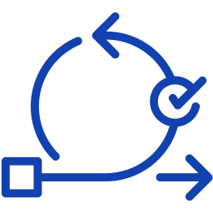
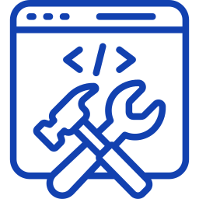


Callback
The Shift from Spec to Ship
Old Way: Dependency Loop
New Way: Independence Loop
PM AS “ASKER”
PM AS “BUILDER”
Idea
Idea
Request Release
Write Spec
Validate Value
Prompt Prototype
Review Staging
Handoff to Eng
Iterate and Fix
Instant Build
Wait for Build
Deploy to Cloud
Notes:
Notes
Recall back to Module 1. We showed you this diagram as the "theory." Now, in Module 6, you have the skills to make it your reality.
The Old Way was the "Dependency Loop." You had an idea. You wrote a spec. Then you waited. You waited for a designer to mock it up. You waited for an engineer to build the MVP. You were a "Requestor," always dependent on someone else's time to see your idea come to life. You were blocked from the market until someone else opened the gate.
The New Way is the "Builder Loop." Now, with your skills in AI Prototyping, you remove the wait time. You don't just mock the idea; you deploy it. You have an idea, you prompt the code, and you push a live URL to the cloud in minutes.
This is a massive shift in the market. We are moving toward a world where PMs aren't just writing tickets; they are shipping value. Whether it’s an internal admin tool or a customer-facing landing page, modern Product Managers are using these tools to ship "v0.1" directly to production.

Slide 8






The Deployment Strategy
Don't just pick a tool; pick a strategy. Your deployment method should match your confidence level in the solution.
High Ambiguity
The Bridge
Low Ambiguity
Ambiguity Spectrum
For Speed and Learning
For Scale, Security and Performance
Deployment for Validation: You are testing a hypothesis. You need a live link immediately to get behavior data, but the code is likely disposable
Engineering Handoff: If the feature is validated but too complex for a PM to ship alone, hand off the prototype to Engineering to rebuild for the core product.
Deployment for Production: You’ve validated user needs. You’re empowering yourself to ship a permanent, scalable product without waiting for a full engineering cycle.
Notes:
Notes
You have two paths for getting a live link, and the choice isn't just about tools—it's about where you sit on the "Ambiguity Spectrum."
High Ambiguity: Deployment for Validation (The "Internal" Path): When your confidence is low and you are still testing a hypothesis, speed is the only metric that matters. As you will shortly see and try for yourself, platforms like Lovable, Bolt, and Replit allow you to deploy directly from the tool, eliminating the need for infrastructure so you can get a link in front of users immediately to learn fast, even if the code is disposable.
Low Ambiguity: Deployment for Production (The "External" Path): When your confidence is high and you are building a permanent solution—like an internal tool or micro-app—you can use managed infrastructure like Vercel or Netlify. This "Advanced" approach empowers you to deploy scalable, production-grade applications yourself, allowing you to ship value directly without waiting for a full engineering cycle.
The Bridge: Engineering Handoff: This is the critical "Middle Step" where you take a validated prototype that is too complex for you to maintain alone and hand the insights to engineering to rebuild for the core codebase.

Slide 9
The Validation Pipeline
Move from "Draft" to "Deployed" to secure the data required for buy-in.
SYNC
PUBLISH
VALIDATE
THE “TRUST” ANCHOR
Connect your cloud-based prototype to GitHub.
Engineers trust repositories, not links. This creates a versioned, portable asset, ensuring your work is ready for handoff and isn't locked inside a proprietary tool.
THE “CONTEXT” SHIFT
Deploy to a live URL and remove the login wall. This removes the "tool chrome" so stakeholders view it on their own device. It shifts their mindset from critiquing a design to experiencing a product.
THE “PROOF” POINT
Share the link for unguided testing. This generates behavioral data so you stop debating opinions and start measuring reality based on interaction, giving you the evidence to secure budget.
REMEMBER: A prototype on your laptop is just a hypothesis; a deployed link generates the undeniable user data required to secure executive buy-in.
Notes:
Notes
Now that you understand why we need to escape the Sandbox. Many PMs get stuck thinking they need complex servers or DevOps engineers to do this. You don't. You just need a specific 3-step pipeline to actually do it safely and effectively.
Sync: This is non-negotiable. Think of GitHub not as a scary developer tool, but as your project's "Time Machine." By syncing here, you create a permanent safety net that allows you to undo mistakes if the live build breaks. More importantly, it signals to engineering that you are managing the code responsibly, turning your prototype from a disposable link into a transferable asset they can trust.
Publish: This is the execution of the strategy we just discussed. By clicking the native "Deploy" button, you instantly generate that clean, public URL. This is the technical action that physically removes the "Login Wall" and "Editor Chrome," ensuring your stakeholders see the product exactly as intended.
Validate: Now you execute the test. Send that new URL to your users and—this is crucial—stop talking. Since the link is live on their device, you don't need to guide them. Just observe. This is the moment you capture the "Behavioral Data" we identified as the key to winning executive buy-in.
Remember, you are shipping your prototype to learn, not to sell. Let’s zoom in on Step 1: Sync.

Slide 10


Prototype Asset Management
GitHub for PMs
Repository (Repo)
The versioned, cloud-hosted codebase.
Strategic Value: Transforms a disposable "session" into a permanent engineering artifact—a single source of truth ready for technical handoff.
Commit
A granular, named snapshot of the codebase at a specific state.
Strategic Value: Enables risk-free iteration where each commit creates a distinct restore point, allowing you to test aggressively and rollback instantly if regressions occur.
Push
The action of synchronizing local changes to the remote repository.
Strategic Value: Updates the shared asset and synchronizes the remote repository to your workspace, ensuring stakeholders access the exact version you validated.
Your prototyping tool has a local "undo" option, but GitHub provides "version control." You don't need to write code to use it; you just need to govern the asset responsibly.
Lovable checkpoints are for drafting. GitHub commits are for saving. Never deploy without pushing to the vault first.
Notes:
Notes
Before you deploy, let’s demystify GitHub and address a question you might have: "Why do I need GitHub if Lovable already has a 'History' tab?"
The difference is Ownership. Lovable's history is great for fixing a typo you made 5 minutes ago. But it's trapped inside the tool. If you lose access to your account, you lose your work.
GitHub is your Safety Net. A lot of PMs are intimidated by this tool, but you shouldn't be. Think of it as "Google Docs for Code." Let's double-click on that first step of the validation pipeline to manage your safety net effectively and understand why GitHub should be part of your core stack for prototype validation.
To sound like a pro when talking to engineers, you only need to know three terms.
The Repo (Repository): This is your Vault. It moves your prototype from a fragile file in Lovable to a secure, permanent folder in the cloud. Even if you delete your Lovable account, the code lives on here.
Commit: Think of this as a "Save Game" slot. Every time you save a version, GitHub creates a Commit. If you try a complex new feature and it breaks the entire app, you don't panic. You just revert to the previous Commit.
Push: This is the verb. In Lovable or Bolt, this button is often called "Sync." When you click it, you are performing a Git Push. You are sending your latest work to the vault.
The PM's Rule: Always Push (Sync) your code before you Deploy. This ensures your safety net is up to date.

Slide 11
Sync Your Prototype to GitHub
Hands-On Lab
Notes:
Hands-On Lab: Sync Your Prototype to GitHub

Slide 12

Breakout Group Exercise
Steps to follow:
Have the member who owns the Lovable prototype you're working on sign in or create a 🔗GitHub account—they are the only ones who need it.
Open your 🔗Lovable project and connect your prototype to GitHub, following the authentication and verification steps in the walkthrough guide.
ℹ️ Note: Once you sync, GitHub becomes the master record. Do not rename or delete the repository in GitHub, or you will break your Lovable project connection.
Configure your prototype's title, image icon, and description before clicking "Publish."
Verify your project is safe and updated in your GitHub repo.
Share the link with your group members for testing.
Sync Your Prototype to GitHub
LAB EXERCISE
10 minutes
In this final lab, you will move your Fitness App from a private sandbox to the public web.
Your goal is to export your code to GitHub to create a permanent "Source of Truth" and deploy a live URL to start the validation feedback loop.
Share your live link in your Slack channel so others can see your prototype!
✍️ Follow along with our walkthrough here
Notes:
Notes
💥Activity: Instructor-Led Exercise
✏️Task: Sync Your Prototype to GitHub
⏱️Time: 10 Minutes
📌 Note for Instructors:The biggest friction point here is GitHub account creation. Ensure the Lovable project owner has a working account before sending them to breakout rooms. Or else, make it clear that they need to be the one to do so once in the room together.
Emphasize that once synced, the GitHub repo is the master record. If they rename or delete it in GitHub, they break their Lovable project.
Push students to actually fill out the "Title" and "Image" in the publish settings. This is a small detail that makes the prototype look professional when shared in Slack/Teams.
Once students get their live links, ask groups to start sharing their links in the Slack channel so others can view and test!
Scenario: In this hands-on lab, students will move move their Fitness App from a private sandbox to the public web. Their goal is to establish a permanent Source of Truth in GitHub (for engineering) and deploy a Live URL (for stakeholders) to start the validation loop.
Instructions:
👉 Make sure students are following along with the detailed walkthrough guide
Identify the project owner in each group—this is the person who owns the Lovable project file. They must be the one to sign in to their GitHub account, or create a free one if they haven't already, as they are the only one who needs it for this step.
Have the group open their Lovable project and guide the project owner to connect the prototype to GitHub, following the specific authentication steps in the walkthrough guide.
Warn the students that once they sync, GitHub becomes the master record, so they must never rename or delete that repository or they will break the connection.
Prompt groups to configure the prototype's Title, Icon, and Description in the publishing settings before they click "Publish," ensuring the link looks professional when shared.
Have the GitHub owner click the repository link to verify that the code is safe and visible in GitHub (The "Save" Point).
Instruct the project owner to share the live URL with their teammates and also in the Slack channel so others can see what their group has done.
Call out that that link will also be added to their final project deliverables deck with the screenshots, and that those groups who will volunteer to demo can walk everyone through their prototype via the live link.
Repeat warning: Only the workspace owner should link GitHub.
If someone else pushes, the project link breaks.
➡️ Reminder to create Breakout Groups in Zoom

Slide 13

Individual Activity
Head to your designated cohort Slack channel
Choose at least two different deployed Lovable links your classmates have shared.
Explore and test their prototype for a few minutes. Then, in the same thread as the link was posted, leave one piece of specific feedback for each you review.
INSTRUCTIONS
10 minutes
Prototype Feedback Loop
Ensure you leave specific detailed feedback in the comment thread for that specific link!
Choose the type of feedback you would like to leave on two different group’s prototype:
🐛 A Bug: "e.g, I clicked X and nothing happened."
🤔 Friction: "I was confused by the label on the submit button."
💡 A Feature Idea: "It would be cool if this saved my data for next time."
Notes:
Notes
💥Activity: Individual Activity
💬Topic: Prototype Feedback Loop
⏱️Time: 10 Minutes
📌 Note for Instructors: If groups haven’t yet shared their links after the lab, stress they need to share in the cohort channel so others can give them feedback.
Scenario: You successfully moved your app from the private editor to a public, shareable URL. So let’s share with our classmates and start getting feedback! Choose the type of feedback you would like to leave on two different group’s prototype: a bug, friction you noticed, or a future feature idea. Head to your designated cohort Slack channel and pick at least two different group’s prototypes to give feedback on.
Instructions:
Choose at least two different deployed Lovable links your classmates have shared.
Explore and test their prototype for a few minutes. Then, in the same thread as the link was posted, leave one piece of specific feedback for each.

Slide 14
Collecting Feedback for Improved Prototype Iterations
Notes:
02. Collecting Feedback for Improved Prototype Iterations

Slide 15
The Product Learning Loop
Shipping your prototype is not the finish line; it’s the beginning of product learning. The goal is to collect unbiased, actionable data. For PMs, user feedback is the only data source that validates your hypothesis and unlocks budget for the next stage.
Trust Builder
The Value: Converts stakeholder opinion into data. Real user behavior proves the prototype’s viability and builds confidence with engineering.
01
Budget Unlocker
The Value: Provides the necessary proof to secure resources. Data is the only language that gets the full engineering build approved.
02
Roadmap Optimizer
The Value: Prevents expensive rework. External usage clarifies the product’s true priorities and stops you from building features users ignore.
03
Notes:
Notes
You’ve how to build the prototype. Now, you need to learn how to leverage the data it collects. This is why feedback is essential.
As PMs you know feedback is essential for data; that’s no different with prototyping. Here’s why it matters for you product learning loop:
The Trust Builder: In the past, you might have shared a prototype and stakeholders gave you their opinion ("I think this button should be blue"). Now, you counter that with data: "Actually, 90% of users successfully completed the task with the current button color. Let's focus on the workflow instead." User data builds trust in the viability of your design.
The Budget Unlocker: You are not getting $100k for an engineering sprint because your prototype looks nice. You are getting it because you have data proving that users will use this feature, they will click "Buy," or they will complete the core task. Data is the only language that gets resources approved.
The Roadmap Optimizer: This is the most critical strategic point. User data prevents massive, expensive rework. You build the feature that users actually need, not the one you thought they needed. This optimizes your entire future roadmap.

Slide 16




Output Quality
Latency Tolerance
Value Capture
Validating Logic vs. Layout
Because your prototype generates real results, observing how often users manually edit or "regenerate" the output proves exactly where the logic failed to meet their intent.
Because your prototype has real processing delays, measuring abandonment while it "thinks" reveals the maximum wait time users will tolerate before bouncing.
Because your prototype produces usable content, observing "theft behaviors"—like screenshots or copy-pastes—provides irrefutable proof that the result is valuable enough to keep.
E.g., Spotify treats a song skip within the first 30 seconds as a specific "failure signal" to retrain their recommendation model.
E.g., Google found that just 400ms of added latency caused a 0.44% drop in daily search volume.
E.g., Instagram weights "Saves" over "Likes" because they indicate content is valuable enough to reference later.
Functional prototypes validate utility. Use your live link to capture behavioral signals static mocks cannot generate.
Notes:
Notes
How do you know if what you’ve built is actually working? Because you are now testing a functional prototype, you can collect signals that static designs simply cannot provide. You can map these signals directly back to the FUDI framework (Functionality, User Flow, Design, Interaction) we used to build our prompts in Module 3.
Here’s how to move beyond validating the layout and dig into your prototype’s logic:
Output Quality (The "Utility" Check): This validates your Functionality. Because your prototype generates real results, you aren't just testing if the code works; you are testing if the answer is right. Watch for manual edits. Think of your final project prototype: If a user generates a workout plan and immediately edits every line or hits "regenerate," that is a behavioral failure signal.
Example: Spotify: Spotify treats a song skip as a failure of their recommendation algorithm, a "regenerate" click tells you your prompt logic needs iteration.
Latency Tolerance (The "Friction" Check): This validates your Interaction. Unlike static mocks which are instant, real AI has processing delays. You need to measure if the "Time-to-Value" is acceptable. Watch for abandonment during the "spinner." Think of your fitness app: If a user decides to leave the prototype or click somewhere else while waiting, that tells you how long (or short!) they’re willing to wait for your idea.
Example: Google: Google found that just 400 milliseconds of latency caused users to drop off. Your prototype is the only place to test if users will actually wait 10 seconds for your AI, or if you need to engineer a faster solution.
Value Capture (The "Fit" Check): This validates the overall User Flow and value proposition. You are moving beyond "sentiment" (asking if they like it) to "utility" (seeing if they keep it). Watch for "theft” behaviours like screenshots or copying. In your fitness app, if a user generates a meal plan and immediately screenshots it to use at the grocery store, that is the ultimate validation. It tells you the output was valuable enough to "take home" and use in real life, even though the app isn't finished.
Example: Instagram: Instagram weights "Saves" higher than "Likes" because a Save indicates deep value. If a user screenshots the meal plan your AI generated to use later, you have irrefutable proof of Product-Market Fit.

Slide 17



High-Fidelity Feedback Methods
Guided Shadowing
Observe users navigating live data to spot silent friction—like hesitation or backtracking—that standard interviews miss.
Session Replays
Review screen recordings to objectively measure patience thresholds and friction during loading states or complex flows.
Contextual Interception
Embed feedback triggers next to specific outputs to capture logic failures the exact moment they occur.
Notes:
Notes
Standard PM advice is to "talk to users." But with a functional prototype, you need to move from asking what they think to observing how they struggle:
Guided Shadowing (The "Silent" Observer): Don't interview; observe. Watch users interact with your prototype live without explaining how it works. That’s because while standard interviews allow users to rationalize their confusion ("I think I would use this..."), in a functional prototype, you need to watch the cursor. If they hover over a button but don't click, or if they navigate to a page and immediately hit "Back," you have captured a behavioral failure signal—an "Unspoken Friction"—that tells you the user flow is broken.
Example: Imagine you built a B2B analytics dashboard. During observation, you notice users consistently hover their mouse over the "Revenue" chart for 5 seconds but never click the "Drill Down" feature.The friction isn't technical; it's conceptual. Users didn't realize the chart was interactive because the hover state wasn't obvious. A survey would have just said "I couldn't find the details," but shadowing revealed why.
Contextual Interception (The "Micro" Loop): Instead of a generic exit survey, place feedback triggers directly on the specific results the prototype generates (e.g., a "report issue" or rating on a dashboard widget). Don't send an email 3 days later asking "Did you like the prototype?" Because your prototype is functional, users are judging specific data points. By placing a simple "Thumbs Down" or "Flag" trigger next to a specific dashboard chart or search result, you capture the exact moment the logic failed them, rather than a vague memory of the experience later. This turns your users into QA testers who help you refine the logic.
Example: Imagine you’ve built an internal search tool for customer support. You place a simple "Is this relevant?" [Yes/No] toggle next to each search result. You discover that while the search loads fast (technical success), the 3rd result is consistently marked "No" (logic failure). This specific data point allows you to tune the ranking algorithm, which general feedback like "Search is bad" would never catch.
Session Replay (The "DVR" Method): Surveys lie; video doesn't. Asking a user "Did it load fast enough?" yields a subjective answer. Watching a recording of them tab-switching to check Slack while your prototype spins gives you the objective truth about their patience threshold. This is the only way to validate the "performance" aspect of your prototype.
Example: Imagine you built a FinTech Loan application prototype. Reviewing recordings reveals that 30% of users "rage click" (click repeatedly) on the "Submit" button during the 3-second API validation pause. The latency is acceptable, but the feedback is missing. Users thought the app froze. The fix wasn't faster code; it was adding a simple "Validating..." loading state to reassure the user.

Slide 18
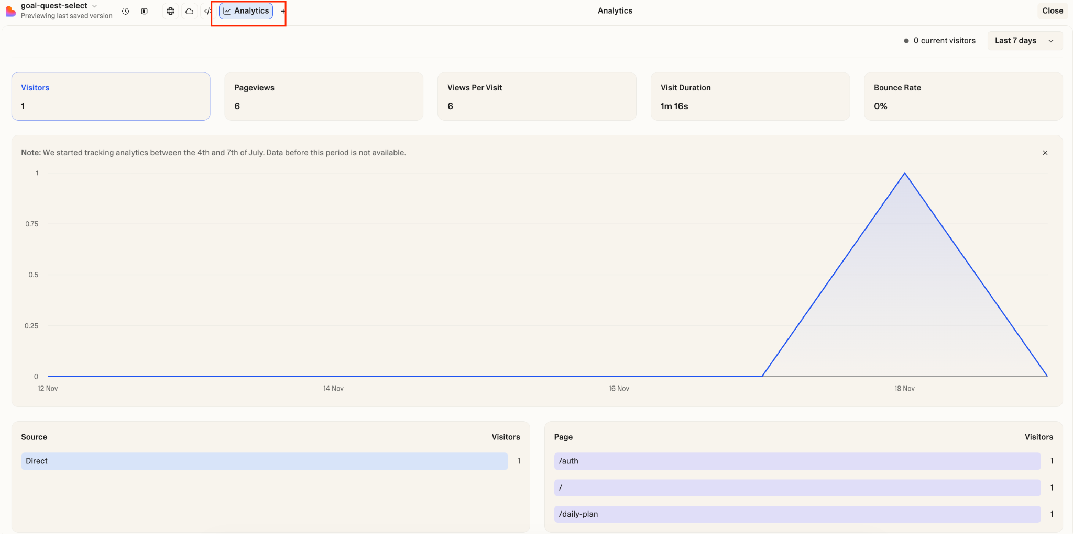
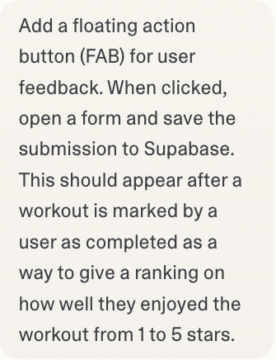
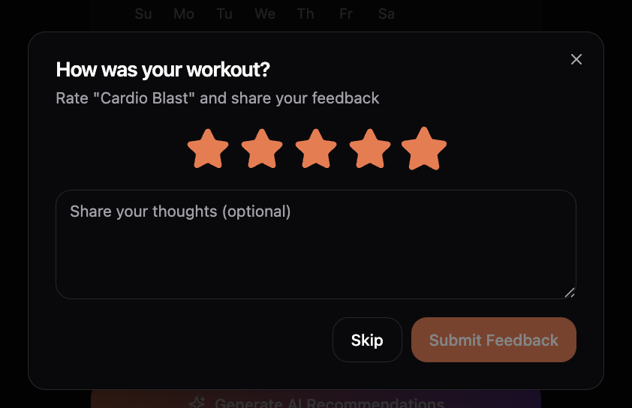
How to Collect Feedback in Lovable
Lovable has built-in features to capture both behavioral data and direct user sentiment directly in your prototype.
Passive Tracking
Active Tracking
Real-time insights built into your published project dashboard.
Measures key behavior stats like visitors, page views, visit duration, and bounce rate.
This can identify drop-off points without asking the user a single question.
Prompt Lovable to build a feedback mechanism directly into your UI
Use a Floating Action Button (FAB) or a dedicated survey page to capture sentiment.
Instruct Lovable to save feedback submissions to a database (like Supabase) so you have a permanent log.
Notes:
Notes
Aside from the regular means of collecting feedback, which you’re likely familiar with as PMs, there are ways within Lovable itself to build direct feedback loops.
Passive Tracking: Once you hit publish, Lovable automatically tracks the basics. You can see visitors, pageviews, and bounce rates right in your dashboard. This maps directly to the "Behavior" signal we just discussed. If your bounce rate is high, your landing page is failing.
Active Tracking: To get Sentiment, you have to ask for it. But you don't need to code a form from scratch. You can simply prompt Lovable to build it for you.
Example: Prompt Lovable and ask for a FAB (Floating Action Button). This appears as a floating icon in the bottom right corner of your screen.
The Prompt: You literally type: "Add a floating action button for user feedback and save it to Supabase".
The Result: Lovable generates the UI, connects the backend, and you start collecting user thoughts immediately.

Slide 19
The Feedback-to-Code Loop
Synthesize: The AI Triage Feed raw transcripts into an LLM to instantly convert unstructured noise into structured categories like UX Friction vs. Logic Failures.
❓KEY QUESTION: Is this a design flaw or a model hallucination?
01
Strategize: The Decision Select the iteration scope based on your synthesis insights by deciding if you need to broadly re-prompt the tool to change underlying behavior or surgically edit a specific visual element.
❓KEY QUESTION: "Does this require a conversational re-prompt or a manual click-to-edit?”
02
Implement: The Auto-Fix Paste the synthesized feedback directly back into your prototyping tool's chat and prompt it to generate the solution or rewrite the logic automatically.
03
❓KEY QUESTION: "How can I ask the AI to implement this fix for me?"
Validate: The Proof Deploy the update immediately and measure specific behavioral metrics to confirm the friction point has been resolved.
❓KEY QUESTION: "Did the core metric I aimed to fix actually move?"
04
Notes:
Notes
Data is useless unless it drives action. We are moving beyond the standard "Build-Measure-Learn" cycle to a tighter "Feedback-to-Code" loop to capture high-fidelity signal. In AI prototyping, you can often iterate faster than you can prioritize a backlog.
Synthesize (The AI Triage): You don't have time to re-watch 10 hours of Session Replays or read every Contextual Interception log. Export the transcripts from your Shadowing sessions or the logs from your "Thumbs Down" triggers. Feed them into an LLM to categorize the chaos. It will tell you: "Users are rage-clicking (Session Replay)" vs. "Users are flagging bad answers (Interception).
Strategize (The Decision): Look at the source of the friction. If your Session Replay showed users struggling to click a button, that is a Visual/Surgical fix (Click-to-Edit). If your Shadowing revealed that users were confused by the AI's answer, that is a Logic/Behavior fix (Conversational Re-prompt).
Implement (The Auto-Fix): Don't summarize the feedback; transfer it. Take the specific quote you heard during Shadowing—"I wish this table showed prices"—and paste it directly into your prototyping tool (like Lovable). Tell the builder: "Here is the user feedback. Update the code to solve this specific friction point."
Validate (The Proof): Close the loop using the same method you started with. If you fixed a loading state found in session replay, watch the new replays—did the hesitation stop? If you fixed a hallucination found via interception, did the "Thumbs Down" rate drop? You aren't done until the signal changes.

Slide 20
Rapid Iteration Techniques
TECHNIQUE | TRANSLATION STRATEGY | ADVANCED PROMPT
Persona Refinement | Convert vague emotional feedback into strict system constraints or parameter adjustments. | Feedback: "The advice is accurate, but it feels cold and generic." Prompt: "Users feel the tone is too clinical. Update the System Persona: 'Adopt the tone of a supportive Run Coach. Use encouraging language, emojis, and never use bullet points without a summary sentence first.’"
Visual Branching | Convert cognitive load feedback into a complete component swap rather than iterating on a broken format. | Feedback: "It's really hard to see which workouts I have coming up in this list." Prompt: "Users are struggling to parse their workout list. Create a new variant of this component that renders the same data as a 'Calendar View' with clickable slots instead of a text table."
Guardrail Injection | Convert trust gaps or fear-based feedback into hardcoded conditional logic rules. | Feedback: "I specifically listed a peanut allergy, but the meal plan included peanut butter toast. That is dangerous." Prompt: "A user reported a critical safety failure. Inject a new Guardrail: 'IF user_profile includes "Allergy", you are FORBIDDEN from suggesting that ingredient. Always cross-reference the ingredient list against the exclusion list before outputting.'"
This is the power of AI prototyping. You don't have to guess. You can build, ship, and test faster than you can hold a meeting about it.
Notes:
Notes
Once you’ve extracted your key insights and are ready to make your next move, here are three specific ways to rapidly iterate using AI as your builder. Remember, AI is your thought partner, but you are the translator. It’s your job to use common sense to decide how to translate user emotion into technical instructions.
Persona Refinement (Reframing the Vibe): After collecting feedback, you need to reframe it from a complaint into a constraint. If a user says "It feels cold," you don't ask the AI "Why is it cold?" You command it: "Adopt a supportive persona." You are translating the emotion (robotic) into a requirement (system instruction). This ensures the AI addresses the specific pain point directly rather than guessing.
Visual Branching (Solving Cognitive Load): Sometimes the data is right, but the user is overwhelmed. This is where you use the AI to swap the mental model. If users are getting lost in a long list, don't ask the AI to "clean up the design." Command it to "Swap this List Component for a Weekly Calendar." Instead of iterating on a format that doesn't work, you use the tool to pivot the entire visualization in 30 seconds.
Guardrail Injection (Hardcoding Trust): If your team (or your users) find a safety gap—like the allergy example—you can't just "hope" the AI gets smarter. You have to force it. Start writing the rules, such as, if the AI fails a safety check, inject a conditional logic statement: "IF allergy, THEN forbid ingredient." You are effectively writing a unit test in plain English to ensure that specific failure never happens again.
Note: Once you’ve identified the right fix, you can make these edits immediately inside your no-code tool (like Lovable). This allows you to fix bugs and pivot features without waiting for a developer. And since you have your GitHub safety net (from the previous section), you can experiment fearlessly—if the iteration breaks the app, just revert the commit.

Slide 21

“Light Eval:” Reality vs. Requirements
To master evaluating AI product performance, join our AI Evals Certification
PRD Metric: Latency
PRD Metric: Accuracy
PRD Metric: Cost
“It should feel instant (< 1s)."
Reality: The OpenAI API takes 4 seconds to think.
"It gives safe, expert advice."
Reality: It suggested a 20-mile run for a beginner.
“It’s cheap to run API calls for the recommended workouts.”
Reality: One session cost $0.15 in credits.
🛠️ The Fix: UX Management
Consider adding a "Skeleton Loader" or "Thinking..." animation to manage user patience.
🛠️ The Fix: Guardrail Injection The "Smart Behavior" needs stricter safety constraints in the system prompt.
🛠️ The Fix: Business Strategy
We can't scale to 1k users yet. We need to use the "Code vs. Credits" workflow to optimize.
Notes:
Notes
Recall back to Module 3, you filled out a "Light Eval" section in your Simplified PRD. At the time, that might have felt like just filling in a form. But after deployment, you have a live URL. That PRD wasn't paperwork; it was a prediction and your feedback metrics will give you the proof you need for validation, iteration, and refinement, Just like a traditional PRD, your simplified PRD for your prototype is also a living document, and will change as you learn.
Keep in mind: These are just examples. This manual "spot check" is appropriate for the prototype phase—it gives you the initial signal you need to get buy-in. However, once you move to full production, the standard changes. You won't be checking these manually; you will implement robust, automated evaluation suites to track performance at scale. (And Product School offers a course on AI Evals for just that!). But for today, these initial metrics are your first line of defense to prove your concept works.
Example Metrics in Your “Light Evals”
Latency: If your metric in the PRD was that workout recommendations should feel instant (less than 1 second), what was the reality? You probably saw in the API integration lab that the OpenAI API take 4 or 5 seconds to "think."
Consider how that impacts the user through the FUDI lens—specifically Interaction. A 5-second freeze feels like the app is broken.
The Fix: The solution isn't necessarily faster code; it's better design. Apply the visual branching technique we just discussed.You implement a skeleton loader or a "thinking" animation to manage user patience. You solve a technical lag with a product design fix.
Accuracy: Perhaps you promised "safe, expert advice." But maybe the AI told a beginner user to run a marathon.
This validates that your Smart Behavior definition was too loose.
The Fix: You need apply guardrail injections. Go back to the System Prompt and add strict safety constraints. You’re fixing the logic, not the code.
Cost: Finally, check your usage dashboard. Did a simple 5-minute test session cost 50 cents?
This proves the Business Case isn't ready to scale to 1,000 users yet.
The Fix: You need to optimize your token usage using the "Code vs. Credits" workflow we discussed in Module 5.
This manual spot-check is how you close the loop. You aren't just checking boxes; you are proving whether your prototype can actually survive in the real world before you hand it off to engineering.

Slide 22
Breakout Group Exercise
Slide 5: Paste screenshots from your build process in Lovable and include your live, shareable, deployed link.
Slide 6: A high-level overview of your simplified PRD and a sharable link to the full, completed artifact.
Slide 7: General insights into the prototyping build process (including aha moments and friction points).
Slide 8: Debugging insights and next steps for additional APIs or API iterations.
Slide 9: Insights on next steps for better governance (secure and safe with AI features) and the future business strategy for your prototype.
🚀 Feel free to adapt, add and adjust the template as best suits your needs. It’s there to give you a baseline, but you can make it your own! The project brief is also linked on slide 2 if you need it.
Prepare & Finalize Your Project Deliverables Deck
KEY SLIDES
20 minutes
To ensure you’ve got time to finalize the details, get together in your groups to work on your deck. If your group is ready, feel free to use the 20 minutes to implement any of the feedback you received from your peers to your prototype!
Remember, each member of your team must submit a copy of the deck into the LSM, but you can all build from one shared deck, then download a copy separately once finished.
🔗 ACCESS: AI Prototyping Final Project Deliverables Template
Notes:
Notes
💥Activity: Breakout Group Exercise
✏️Task: Prepare and Finalize Your Project Deliverables
⏱️Time: 20 Minutes
Instructions: You will have 20 minutes to get together in your groups and finalize the slide deliverables you must submit into the LMS. Open your Final Project Deliverables Template. You are all building from one shared deck, but remember that each member must download and submit a copy individually to the LMS to get credit.
Slides in the Template to Cover:
On Slide 5, show the Proof. Paste the screenshots of your build process in Lovable, but most importantly, include the live, shareable, deployed link you just generated. We want to click it.
On Slide 6, show your requirements. Give us the high-level overview of your Simplified PRD and a link to the full artifact.
On Slide 7, tell the Story. Share your general insights on building prototypes with an AI tool like Lovable. What were the 'aha' moments? Where was the friction?
On Slide 8, show the Technical Reality. We want to see your debugging insights and your plans for future API iterations. This proves you understand the complexity.
On Slide 9, show the Strategy. This is the 'Senior PM' slide. Share your insights on governance—how will you keep this safe and secure with AI features?—and the future business strategy.
Use your time to polish things off, share any links or screenshots, and write your thoughts. If your group is finished, you can use the 20 minutes to review some of the feedback your peers left and implement any changes. After the break, we will start hearing from groups that volunteered to present!

Slide 23
Estimated time: 5 minutes
Notes:
Notes
Time for a 5-minute break—you’ve earned it! ☕

Slide 24





Reminder! 🚨
It's always better to see your smiling face! Be present and visible to stay engaged and keep interactions valuable.
Cameras On
Notes:
Notes Here’s a quick reminder to encourage students to turn their cameras on after the break so engagement stays high! No one is perfect, but seeing classmates faces makes the experience better.

Slide 25
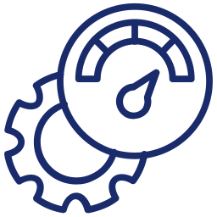
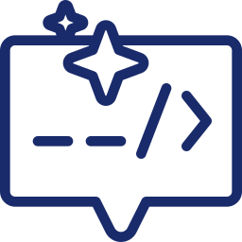

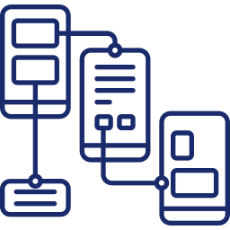
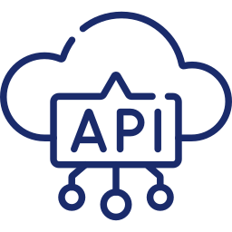
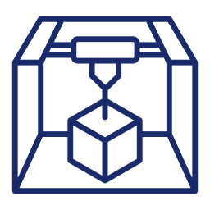
Learner Journey
1
2
3
4
5
6
Accelerate the Idea-to-Validation Cycle
Write Advanced Prompts for High-Fidelity Prototypes
Define the Modern Specs for Prototype Development
Build, Iterate, and Debug Prototypes End-to-End
Power Advanced Prototypes
With API Integrations
Deploy and Scale Prototypes for Production
The New Language: Moving from simple commands to structured prompting. The Win: Using advanced techniques like Reflection and Meta- Prompting to generate high-fidelity results.
The Blueprint: Moving from static, quickly outdated docs to a living, Simplified PRD. The Win: Using the FUDI framework (Functionality, User flow, Design, Interaction) to architect prototype specs and prompts.
The Build Cycle: Moving from “happy path" to resilient logic.
The Win: Applying the four core debugging strategies (Reflection, Batching, Specification, Versioning) to make iterative changes.
The Intelligence: Moving from static to real-world data.
The Win Using the AI Sandwich to integrate live APIs and secure data cost-effectively.
The Validation: Moving from sandbox to live deployment.
The Win: Establishing a GitHub Source of Truth and deploying a live URL to generate the behavioral data needed for buy-in.
The Mindset Shift: Moving from abstract ideas to tangible value. The Win: AI Prototyping now reduces time-to-validation from weeks to minutes to get buy-in faster with less resources.
Notes:
Notes As we near the end of this course, let's review the specific toolkit you've built towards mastering a new, professional, AI-powered workflow.
In Module 1, you learned the value. You experienced that "wow" moment with Bolt and realized that in today's environment, a PM isn't just a spec-writer; you are a builder. You learned that the fastest path to value isn't a document, it's a prototype, and with AI-tools you can get the buy-in you need for your ideas much faster and with less resources too.
In Module 2, you learned the language. You moved beyond basic chat to structured prompting, strategic and cutting-edge techniques (like Reflection and Meta-Prompting) to craft better prompts to build your prototype and get the outcome you want.
In Module 3, you mastered the Simplified PRD. You learned that the FUDI Framework is the bridge between a vague idea and a working feature and your spec is what helps you structure and craft your prompting packs.
In Module 4, you learned that the real work is debugging by building modularly, so you can isolate issues easier. You applied the Four Core Strategies—like Batching and Specification—to de-risk the logic and make improvements to your prototype.
In Module 5, you gave your prototype a brain. You connected APIs and used the AI Sandwich to fix hallucinations and to prove your idea works with real data.
And today, in Module 6, you deployed. You moved out of the sandbox, established a Source of Truth in GitHub, and put your prototype in users hands so you can start the feedback loop for iterations.
Hopefully, you now feel ready to validate any idea, anytime, without waiting for permission!

Slide 26
Final Project Showcase: Demo Your Prototype
Notes:
03. Final Project Showcase: Demo Your Prototype

Slide 27
Important Reminder:
To qualify for certification, please ensure you upload and submit your own copy of the final project deliverables in our LMS.
LAUNCH LMS
Notes:
Notes
📌 Note for Instructors: Give students a quick overview again of what students must cover in their deliverables.
Note that all students are required to submit their final project deliverable in Doebo in order to qualify for certification. Students will have seven days from when course is finished to submit.

Slide 28




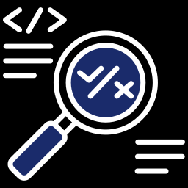

REMINDER: Your Project Deliverables
Must Have
Final AI Prototype Screenshots & Live Link
Simplified PRD Summary
Insights from the Build Process
Debug, Iteration, and API Insights
Group Insights on Governance & Strategy
Notes:
Notes
📌 Note for Instructors: Give students a quick overview again of what students must cover in their deliverables.
Final AI Prototype: Provide the link and key visuals for your working AI prototype in Lovable. Include a live demo link ( and 1-2 key screenshots of your final prototype’s UI for your chosen scenario.
Simplified PRD (Prototyping Requirements One-Pager) Summary: Present the key strategic decisions from your PRD artifact. Focus on summarizing the core product overview and smart behaviors that guided your prototype. Include a link to the full artifact.
Insights from the Build Process: Reflect on the experience of building your prototype. Identify the biggest friction points your group faced, your key "aha" moment, and what you learned about the gap between a design spec and a functional prototype.
Debug, Iteration, and API Insights: Share your most significant debug and iteration highlights from the build process. Identify 1-2 key Future API Integrations this prototype would need and provide a brief Insight on the value or challenge of integrating these APIs.
Group Insights on Governance & Strategy: Articulate your group's key takeaways. Propose the next steps for governance and the future business strategy if you plan to move forward with your prototype.

Slide 29


Presentation Kick-Off:
Your Time to Shine 🌟
Make sure to keep track of time! You'll have roughly 10 minutes to demo and share your insights.
IMPORTANT
You have 7 days after the course completes to submit.
Notes:
Notes
Now its group’s turns! Call on the first group to present and get them to share their screen. Let them know they will have about 10 min to present, and you might need to cut them off if they’re going over.
Feel free to give a 6-7 minute warning as group’s present.
Your live feedback should reflect the same as the rubric, but in more detail:
Project Clarity
Credibility and Reasoning
Strategic Thinking
Application of Conce

Slide 30
Key Takeaways
Deploy and Scale Prototypes for Production
Deployment transforms prototypes into truth. Moving from a local sandbox to a live URL shifts stakeholder feedback from subjective opinions to objective behavioral data.
Version control establishes the single source of truth. Using GitHub as a safety net and handoff artifact bridges the gap between design intent and engineering reality.
Shipping is the beginning of product learning, not the end. Collecting behavioral, usability, and sentiment signals turns raw usage data into the roadmap for the next iteration.
Rapid iteration is the modern Product Manager's competitive advantage. Leveraging AI to analyze feedback and generate instant fixes creates a continuous cycle of improvement and validation.
Notes:
Notes
At the end of each module, recap key concepts and content covered in today’s lesson.

Slide 31

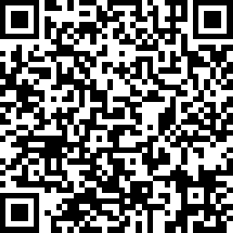
Share here
Your Opinion Matters To Us
We’d love to hear about your experience!
At the end of each session, please scan the QR code or use the link to share your feedback.
Your insights help us improve and make each cohort better than the last.
🔗 https://www.surveymonkey.com/r/QK7GH7B
Notes:
Notes
We will be having daily surveys at the end of each class, and your opinion matters to us.
This is crucial in making sure our team can learn the best way to support you, and if we are also hitting the mark, Like real product managers, we would want to iterate and adjust so that we can support your needs.

Slide 32


Resources & Templates
AI PROTOTYPING CERTIFICATION
HANDS-ON LAB WALKTHROUGH
AI Prototyping Final Project Grading Rubric
Module 6 Lab Guide
View resource
View resource
Notes:
🗂 Bonus Resources
Here are some additional resources students can learn to deepen their knowledge of what we have covered in this section.

Slide 33
Q&A
Notes:
Notes
💥Activity: Q&A
This is a chance to dive deeper into the topics covered and answer any additional questions students may have!

Slide 34
Notes:
Thank you 💥

